Slide 1


JavaFX: Java's new Rich Client Platform
Presenting with
LOGO

Slide 2

Agenda
Background
Technical Details
Roadmap
JavaFX in Action (Demos)
Notes:
This session will look at the background for JavaFX, look at some of the technical details for its implementation, quickly highlight the roadmap and then show a number of demos

Slide 3
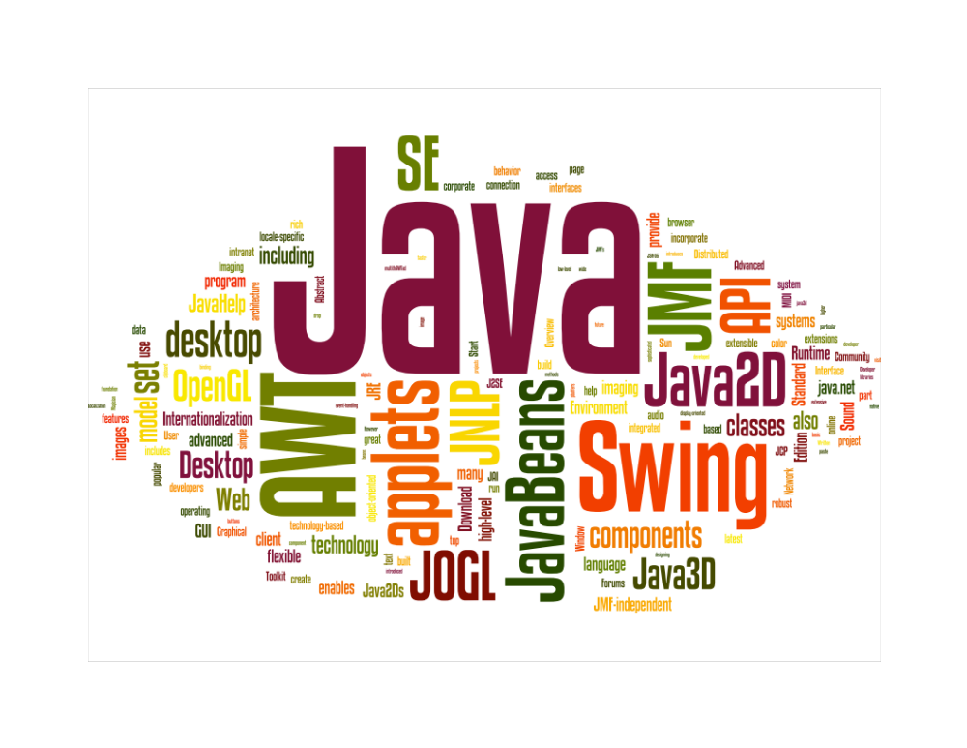
Java Pioneered Rich Client Applications
But developers had to learn multiple technologies
Notes:
Java pioneered rich client applications years ago with applets and cross-platform graphics
Over the years there have been some amazing rich and expressive client applications that have been built with Java
However building a graphically rich application in Java required a developer to work with different technologies such as AWT, Swing, Java2D, JOGL or Java3D etc.
This made development complex and time consuming.

Slide 4
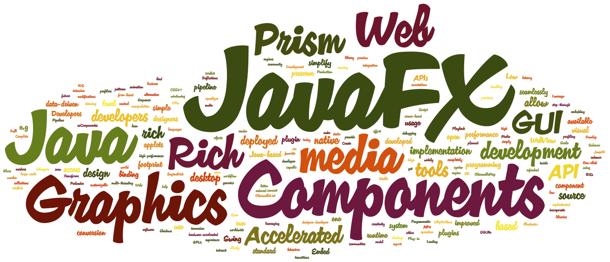
JavaFX Simplifies Application Development
Developers Focus on Capabilities Instead of Technologies
Notes:
JavaFX simplifies the complexity of building complex graphically rich client applications
It provides a simple API library that developers can easily use to add graphics, media, web content, UI controls etc to their applications
This way developers no longer have to worry about figuring about which technology to use for a task. Instead they can only focus on what functionality they need and then use the appropriate JavaFX API
JavaFX 2.0 introduces a number of new features to the Java platform. To name a few high-performance hardware accelerated graphics, embedding of web content, stable media playback, integration with Swing applications, and an improved UI controls library
Imagine a world where you have java.*, javax.*, and javafx.*. That is how we view it. JavaFX fits right in with the rest of the Java libraries and ecosystem. Same languages. Same VM. Same conceptual models (JavaBeans etc). It improves on many of these things, but fundamentally JavaFX is simply the next iteration, or evolution, of Java client.
Now you might ask, which customers? Our customers are you – the big companies, the enterprises, the ISV’s that support and deliver to those enterprises. JavaFX is designed to work well for graphically rich applications, consumer applications, and big data enterprise applications
And to drive home this point – JavaFX’s value proposition is around helping our customers save money by using our platform. By reusing the talent they already have, and the knowledge around libraries they already have, we provide value.

Slide 5

JavaFX is the Evolution of Java as a Rich Client Platform.
It is designed to provide a modern Java environment featuring a lightweight, hardware accelerated UI platform that meets tomorrow’s needs.
Notes:
Definition of the JavaFX platform and some of the high level sets of features. JavaFX provides the following value propositions
Leverage your Java development skills: JavaFX applications are completely developed in the Java programming language, one of the most widely adopted technologies to develop and deploy software applications, which leverages standards-based programming practices and design patterns.
Create without boundaries: JavaFX provides a rich set of graphics and media APIs with high-performance hardware-accelerated graphics and media engines to simplify development of immersive visual applications.
Preserve investment in Java: JavaFX developers can preserve existing investments by reusing Java libraries in their JavaFX applications. They can even access native system capabilities via the Java native interface, or seamlessly connect to server-based Java EE middleware applications.
Familiar Java development tools: Developers can use their favorite Java development tools, such as the NetBeans and Eclipse IDEs, for development of JavaFX applications. All the standard IDE features, including syntax highlighting, auto-completion, interactive step-through debugging, and profiling are available for JavaFX developers.
Deploy on the desktop or in the browser: JavaFX applications can be deployed either as desktop applications or in-browser applets with the help of the Java browser plugin. The improved Java browser plugin provides JavaFX applications a secure way to run inside a browser. When deployed on the desktop, JavaFX applications get the benefits of better performance and native operating system integration.

Slide 6
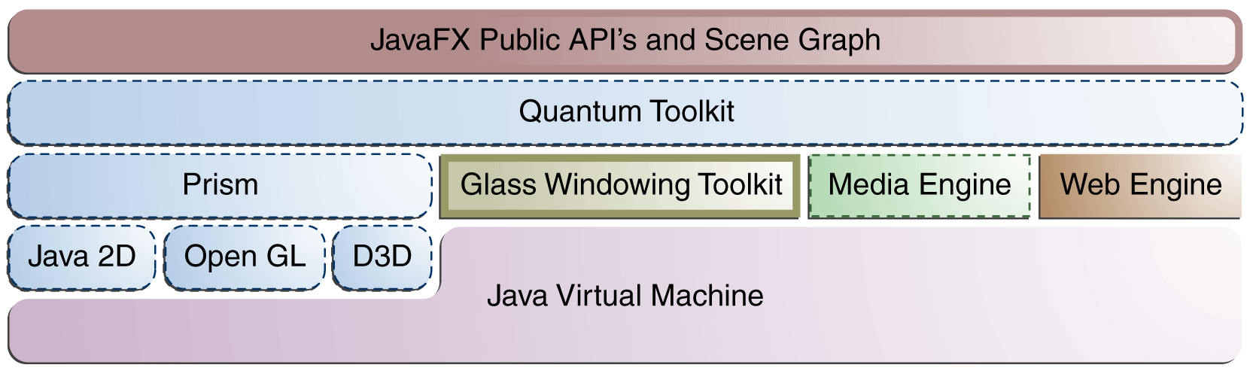
JavaFX Runtime High Level Architecture
JavaFX Glossary
Glass Windowing Toolkit: Provides native operating services, such as managing the windows, timers, and surfaces
Prism: Graphics pipeline that can run on hardware and software renderers
Quantum Toolkit: Ties Prism and Glass together and makes them available to the JavaFX APIs
Notes:
This diagram illustrates the architectural components of the JavaFX 2.0 platform.
Below the JavaFX public APIs lies the engine that runs your JavaFX code. It is composed of subcomponents that include a new high performance graphics engine, called Prism; the new small and efficient windowing system, called Glass; a media engine, and a web engine. The Quantum Toolkit ties Prism and Glass Windowing Toolkit together and makes them available to the JavaFX layer above. It also manages the threading rules related to rendering versus events handling.
Prism is designed to take advantage of the latest GPUs to provide hardware accelerated graphics and minimize the load on the CPU for complex graphics operations. On Windows Prism uses Direct X for this while on other platforms (Mac, Linux) Prism uses OpenGL. On systems where there is no compatible GPU, Prism falls back to the Java2D software pipeline. So your JavaFX applications can continue to run even on older systems or systems with less resources.

Slide 7
JavaFX 2.0 Scoreboard
Released on time (October 2011) | ✔
All functionality exposed through Java APIs | ✔
JavaFX and JavaScript/HTML5 interoperability | ✔
High performance 2D and 3D graphics engine | ✔
Designed to exploit modern advances in desktop and mobile | ✔
Make JavaFX UI Controls available open source | ✔
Complete and integrated development lifecycle experience | ❖
✔ Done  In progress
Notes:
Interoperability between JavaFX, JS, and HTML 5: we’ve done a lot of progress with WebView, which supports part of the HTML 5 specification, as well as Java to JavaScript interoperability. JS to Java interoperability, as well as enhanced HTML5 support are in the planning phases.
- The feedback we have received from the market is that what people want is really JavaFX on the desktop, and native version tablets and smartphones. Most people prefer native over HTML on modern devices
Designed to exploit modern advances in desktop and mobile: we support DirectX for Windows, and OpenGL ES 2.0 or better on other platforms. We still have work to do to support other features, but we’re on track to deliver
Development life cycle experience: We’ve done some progress (Scene Builder EA, NB 7.1 with visual debugging, and support for Java IDEs, Coin, Graphics), but we still need to make more progress with regards to a replacement solution for Production Suite, as well as support for Data Binding
Open Source: you may think we have not delivered, but in fact we plan to open source all of JavaFX on OpenJDK. The first drop of code will be the UI Controls

Slide 8
Java APIs and FXML
Java APIs for JavaFX
FXML
  End-to-end Java development
  Java language features - generics, annotations, multi-threading
  Fluent API for UI construction
  Alternative JVM supported languages (e.g. Groovy, Scala) with JavaFX
  Leverage sophisticated Java IDEs, debuggers and profilers
  Java APIs preserve convenient JavaFX Script features (e.g., bind)
  Scriptable, XML-based markup language for defining UI
  Convenient alternative to developing UI programmatically in Java
  Easy to learn and intuitive for developers familiar with web technologies or other markup based UI technologies
  Powerful scripting feature allows embedding scripts within FXML. Any JVM scripting language can be used, including JavaScript, Groovy, and Scala
Notes:
Self explanatory

Slide 9
Graphics and Media
New Graphics Pipeline
Media
  New hardware accelerated graphics pipeline (Prism)
  New windowing toolkit (Glass) for Prism
  Java2D software pipeline under Prism
  High-level support for making rich graphics simple
    Shadows, Blurs, Reflections, Effects, 2D transforms
    3D Transforms today; Full 3D objects in future
  Stable media framework based on GStreamer
  VP6, MP3 playback of Web multimedia content
  Low latency audio
  Alpha channel support
  Performance improvements
  Full screen video
Notes:
Self explanatory

Slide 10
WebView and Swing Interoperability
WebView Component
Swing and SWT Interop
Browser Plugin
  Embed Web content in JavaFX applications
  HTML rendering based on Webkit
  Hardware accelerated rendering using PRISM
  DOM access and manipulation
  Embed JavaFX content into existing Swing applications
  Extend existing Swing applications with new JavaFX features such as WebView and high-performance graphics
  Applies to SWT applications as well
  Faster loading of JavaFX Web applications based on Prism
  Pre-loader for improved user experience with JavaFX Web applications
Notes:
Self explanatory

Slide 11
Open Source and Standardization
JavaFX source code being contributed as part of OpenJFX
http://openjdk.java.net/projects/openjfx/
  Source code being contributed in phases
  Initial phase: UI Controls
Oracle is committed to standardize JavaFX through JCP
  One or more JSRs will be submitted
  Expected to be become part of the Java SE specification
Notes:
Oracle announced at JavaOne San Francisco 2011 that it would be open sourcing JavaFX. This will be done through the OpenJFX project. Oracle have also commited to standardising JavaFX through the Java Community Process to ensure that interested parties can provide input.

Slide 12
Distribution and Support
JavaFX Distribution
  JavaFX Runtime can now be distributed with third party applications
  Applies to JavaFX 2.0.2 and higher
JavaFX Platform Commercial Support
  JavaFX is now part of the Java SE technologies covered through Oracle Premier Support
  Applies to JavaFX 2.0.2 and higher
Notes:
Starting with JavaFX 2.0.2, JavaFX is available under the same license and business model as Java SE. This includes the ability to distribute the JavaFX Runtime (or SDK) for third party developers with their application(s), subject to the terms and conditions of the license.

Slide 13
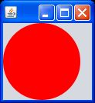
Let’s Compare: JavaFX 1.x
import javafx.application.*;
import javafx.scene.shape.*;
import javafx.scene.paint.*;
Stage {
scene:Scene{
Content:[
Circle {
centerX: 50
centerY: 50
radius: 50
fill: Color.RED
}
]
}
}
Notes:
This slide shows the JavaFX 1.x code to draw a circle in a window. The scripting language was like JavaScript but with simple integration of all standard Java libraries as well as third party ones.
Unfortunately, developers didn’t want to learn a new scripting language.

Slide 14
Let’s Compare: JavaFX 2.0
public class JavaFXTest extends Application {
@Override public void start(Stage stage) {
Group root = new Group();
Scene scene = new Scene(root,100,100);
stage.setScene(scene);
Circle c1 =
new Circle(50.0f, 50.0f, 50.0f, Color.RED);
root.getChildren().add(c1);
stage.setVisible(true);
}
public static void main(String a[]) {
Launcher.launch(JavaFXTest.class, null);
}
}
Notes:
JavaFX 2.0 is a pure Java API. Anyone who knows how to program in Java can use JavaFX. There are some small additions to the way an application startsm but these are minimal and easy to understand.

Slide 15
Let’s Compare: FXML
<BorderPane>
<center>
<Circle radius=“50” centerX=“50” centerY=“50”/>
</center>
</BorderPane>
public class JavaFXTest extends Application {
@Override public void start(Stage stage) {
stage.setTitle(“FXML Example”);
Parent root = FXMLLoader.load(getClass().getResource(“example.fxml"),
ResourceBundle.getBundle(“r.fxml_example"));
stage.setScene(new Scene(root));
stage.show();
}
}
Notes:
JavaFX also supports a markup language, FXML, which allows the layout of components to be specified separately from the code that controls them. Here is the same example of a cirlce using FXML.

Slide 16
Scene Graph
Directed Acyclic Graph
Parents and children
Representation of the GUI components
Notes:
AWT and Swing use a container/component hierarchy for organising the GUI. Layout managers are fundamental to this, but can make development difficult and involved. JavaFX uses a scenegraph which will be familiar to developers who have programmed in 3D. The concept is that all components in the GUI are represented by nodes. Each node can have one parent and groupings can be made by attaching multiple nodes (which may themselves be parents) to a parent. Applying effects to groups of nodes is simply a matter of applying the effect to the parent node. Z ordering can also be altered within a group and for a group as a whole.

Slide 17
Media
JavaFX supports both visual and audio media
Cross-platform JavaFX media file format (fxm, mp3)
  Platform specific formats supported via native players
Media class represents a media file
MediaPlayer provides control of the media rendering
MediaView uses MediaPlayer to render media as Node
  Many MediaViews can use the same MediaPlayer (cheaply)
Notes:
Rich video and audio media is supported on all client platforms so JavaFX needs simple ways to use media. JavaFX uses platform specific players like Windows Media Player, QuickTime and Gplayer, but will also handle software rendering if cross platform codec support is required.
The Media class provides the representation of a media source file. Controls are added to this with the MediaPlayer class (start/stop, pause/resume, forward/back).
MediaView makes the MediaPlayer available as a node for the scenegraph. Multiple MediaViews can use the same MediaPlayer; the design of this means it does not place a big overhead on system resources.

Slide 18
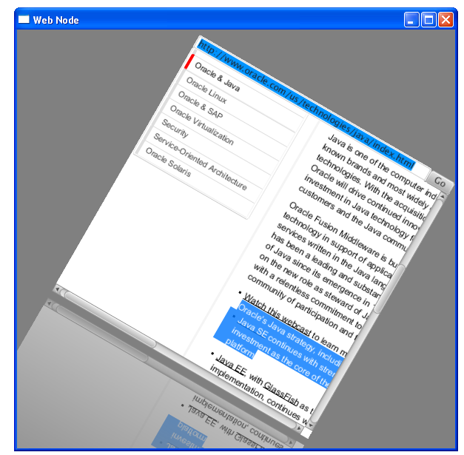
Adding HTML Content
The Embedded Browser
WebEngine
  Provides basic web page browsing functionality
  Supports user interaction: navigating links, submitting forms
WebView
  Web page as a Node in scenegraph
    Effects can be applied
  Encapsulates WebEngine object
  No plugin support

Slide 19
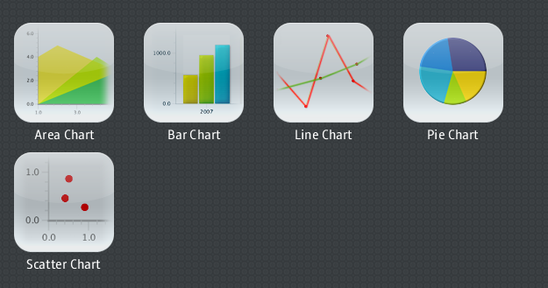
Charts
Notes:
JavaFX provides a rich set of charting controls that simplifies the display of complex data as a single picture.

Slide 20




Effects...
GaussianBlur
InnerShadow
Reflection
SepiaTone
Notes:
To improve the richness of a GUI JavaFX provides a comprehensive set of effects that can be applied to nodes. Remember that media is a node, so all of these effects can be applied to media just as easily as to shapes or controls.

Slide 21
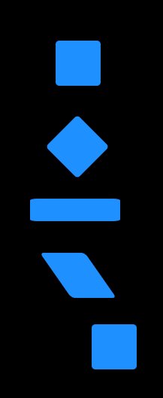
Transforms
Rectangle rect=new Rectangle(0,0,60,60);
rect.setFill(Color.DODGERBLUE);
rect.setArcWidth(10);
rect.setArcHeight(10);
rect.setRotate(45);
rect.setScaleX(2);
rect.setScaleY(0.5);
Shear shear = new Shear(0.7, 0);
rect.getTransforms().add(shear);
rect.setTranslateX(40);
rect.setTranslateY(10);
Notes:
Nodes can be transformed in standard ways or an affine transform matrix can be used.

Slide 22
Binding
Creates a dependency between a property and a changeable value
High level API
  Easy to use
  Covers most common situations
Low level API
  Allows for more complex interactions
  Optimised for fast execution and small footprint
Notes:
Binding is one of the most powerful features of JavaFX. It allows developers to specify the relationship between properties and values so that when the value changes the property is automatically modified byt the JavaFX runtime system. This is analogous to the listener pattern used extensively in AWT/Swing but requires less coding by the developer.
The API is separated into a high level version that covers most of the common tasks, but does not provide total flexibility. For tasks that require complete flexibility the low-level API can be used. This, however, requires more coding.

Slide 23
Properties
Basis for high level binding API
Concrete types for all primitives, String and Object
  DoubleProperty, StringProperty, etc
Simple API
  bind / unbind
  bindBidirectional / unbindBidirectional
  isBound
Notes:
Properties are the basis for high-level binding. There are property types for all Java primitives as well as String and Object. The API for this is simple, allowing you to bind or unbind the property. Bi-directional binding is also supported.

Slide 24
Simple Binding Example
private SimpleDoubleProperty topXProperty =
new SimpleDoubleProperty();
private SimpleDoubleProperty topYProperty =
new SimpleDoubleProperty();
Line foldLine = new Line();
foldLine.setEndX(200);
foldLine.setEndY(200);
foldLine.startXProperty().bind(topXProperty);
foldLine.startYProperty().bind(topYProperty);
...
topXProperty.set(tx);
topYProperty.set(ty);
Notes:
Here we have a simple binding example.
We create two properties that we will modify the values of.
We bind these to the start X and Y co-ordinates of a line.
Whenever we change the values of the properties the line’s position will automatically change (this could be, for example, through a timeline or by ising a mouse) position)

Slide 25
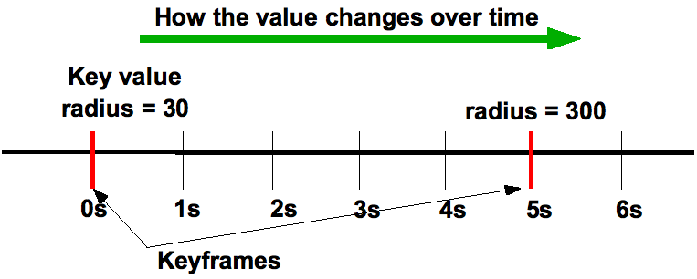
Timeline Based Animations
Timeline
  Modifies values of variables specified in KeyFrames
KeyFrame: specifies that a variable should have
  A particular value at a particular time
KeyValue: Value to be interpolated for an interval
Notes:
Animations are changes in properties that happen over time (fading by modifying opacity, moving the position of a node, etc).
JavaFX uses a Timeline to implement this; each one consisting of a series of KeyFrames. These are points in time where a property will have a specified value (it can also be used to start an action through a method call). The KeyValue has one or more KeyValues that represent the property-value tuple. When a Timeline is started the JavaFX runtime will alter the value of the property automatically. By binding to the changing property the GUI can be animated.

Slide 26
Animated Transitions
Pre-defined, single-purpose animations
  Fade, Path, Pause, Rotate, Scale, Translate
  Can specify to, from and by values
Container transitions
  Parallel, sequential
  Can be nested arbitarily
Transitions and Timelines share ancestary
  A Timeline can be added to a Parallel / Sequential transition
Notes:
To simplify comman tasks JavaFX includes a number of animated transitions to automate things like fading, rotation, scaling and so on. The start end and intermediate points can all be specificed. These can then be grouped together to provide either sequential or parallel transitions. For non-standard animations arbitary Timelines can also be included in the parallel or sequential transitions.

Slide 27




Standard Java Tools for Easy Development
  Source editor with improved syntactic highlighting, code completion, refactoring etc.
  Full debugger and profiler support
  Project wizard for easy creation of JavaFX applications
Other Java IDEs
  Source editor with syntactic highlighting, code completion, refactoring etc.
  Full debugger and Profiler support
Notes:
JavaFX applications are created in Java, developers can take advantage of all the standard Java IDE features. Oracle has included specific JavaFX support in NetBeans 7.1, and we are aware of similar efforts in the eclipse and IntelliJ communities

Slide 28
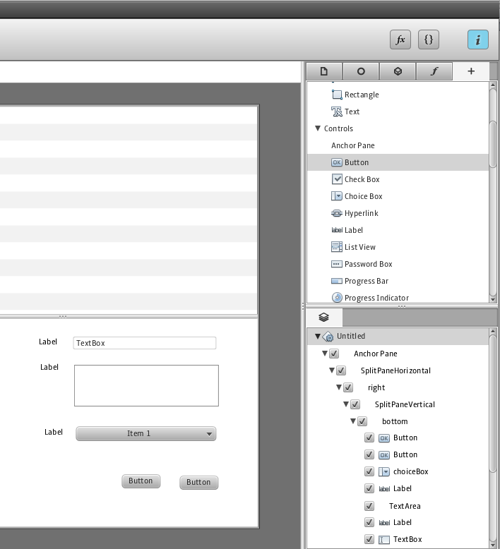
JavaFX Scene Builder for Rapid UI Design
WYSIWYG GUI design tool for the JavaFX platform
Enables designing user interface screens by simply dragging and positioning GUI components from a palette onto a scene
Generates files in FXML format that can be used within a project in any IDE such as NetBeans or Eclipse
Can be used to create GUI for desktop and Web applications
Currently in Early Access (by invitation)
Notes:
Self explanatory

Slide 29
JavaFX Future Directions
Oracle’s Next Generation Java Client Solution
Tighter Integration with Java SE
Migration Path for Java Client UI Technologies
Optimized Web Services Support
Advanced Tooling
Support for Modern Device Interactions
Delivering on the Cross Platform Promise
Notes:
One of our key goals is to fully align JavaFX with the Java SE platform, which will take the form of a full integration with Java 8. We also plan to file a JSR tostandardize the JavaFX APIs, with the objective to include JavaFX under the JDK 9 umbrella JSR
We also want to provide a migration path for the SWT community. Just like Swing, the SWT component framework has been aging, and we think JavaFX code can be integrated in SWT applications jjust as easily as what can be done today with JavaFX and Swing
We are preparing a full fledge JavaFX 3.0 release, with concurrent availability on Windows, Mac OS, and Linux, advanced data services support, such as offline data persistence and synchronization and messaging, modularity support, and more.
We will also focus on providing a better developer tool chain, including the general availability release of JavaFX Scene Builder, and better integration with Java IDEs
Support for modern devices interactions is one of our goals. We’ve started with hardware acceleration, but we are looking at suppoting more featutres (e.g. camera, accelerometer), as well as an easy way to publish applications for tablets and smartphones

Slide 30
JavaFX is …
Cross platform: Windows GA, Mac & Linux Dev. Preview
Familiar: 100% Java APIs
Powerful: leverages underlying Java platform
Modern: CSS skinning, HW acceleration, Webkit
Backwards ‘compatible’: Swing & SWT interoperability
Flexible: applicable to embedded, tablets and mobile
Open Source: http://openjdk.java.net/projects/openjfx
Notes:
Self explanatory

Slide 31
JavaFX Roadmap
JavaFX 3.0
Included in JDK 8
Concurrent OS support
(Windows, Mac OS, Linux)
JavaFX 2.0
Windows GA
Mac OS X Dev. Preview
JavaFX 2.1
Mac OS X GA
Linux Dev. Preview
2011
2012
2013
2014
JavaFX 2.0.2
JDK 7 co-install
JavaFX 2.2
Linux GA
JavaFX
Scene Builder EA
JavaFX
Scene Builder GA
NetBeans 7.1
JavaFX 2.0 Support
NetBeans
JavaFX 3.0 Support
Notes:
The current roadmap shows that this year Oracle will deliver on the cross-platform promise of JavaFX. The Mac OS version will go GA and a developer preview of the Linux version will also be launched. Improvements in tooling will be centred around updates to NetBeans and the GA release of the scene builder tool.

Slide 32
Resources
JavaFX website: http://javafx.com
Open source project
http://openjdk.java.net/projects/openjfx/
Oracle Premier Support for Software
http://www.oracle.com/us/support/software/premier/
Blogs
  http://fxexperience.com
  http://blogs.oracle.com/javafx
Twitter: @javafx4you
Notes:
A list of resources for finding more information.

